Slide 1

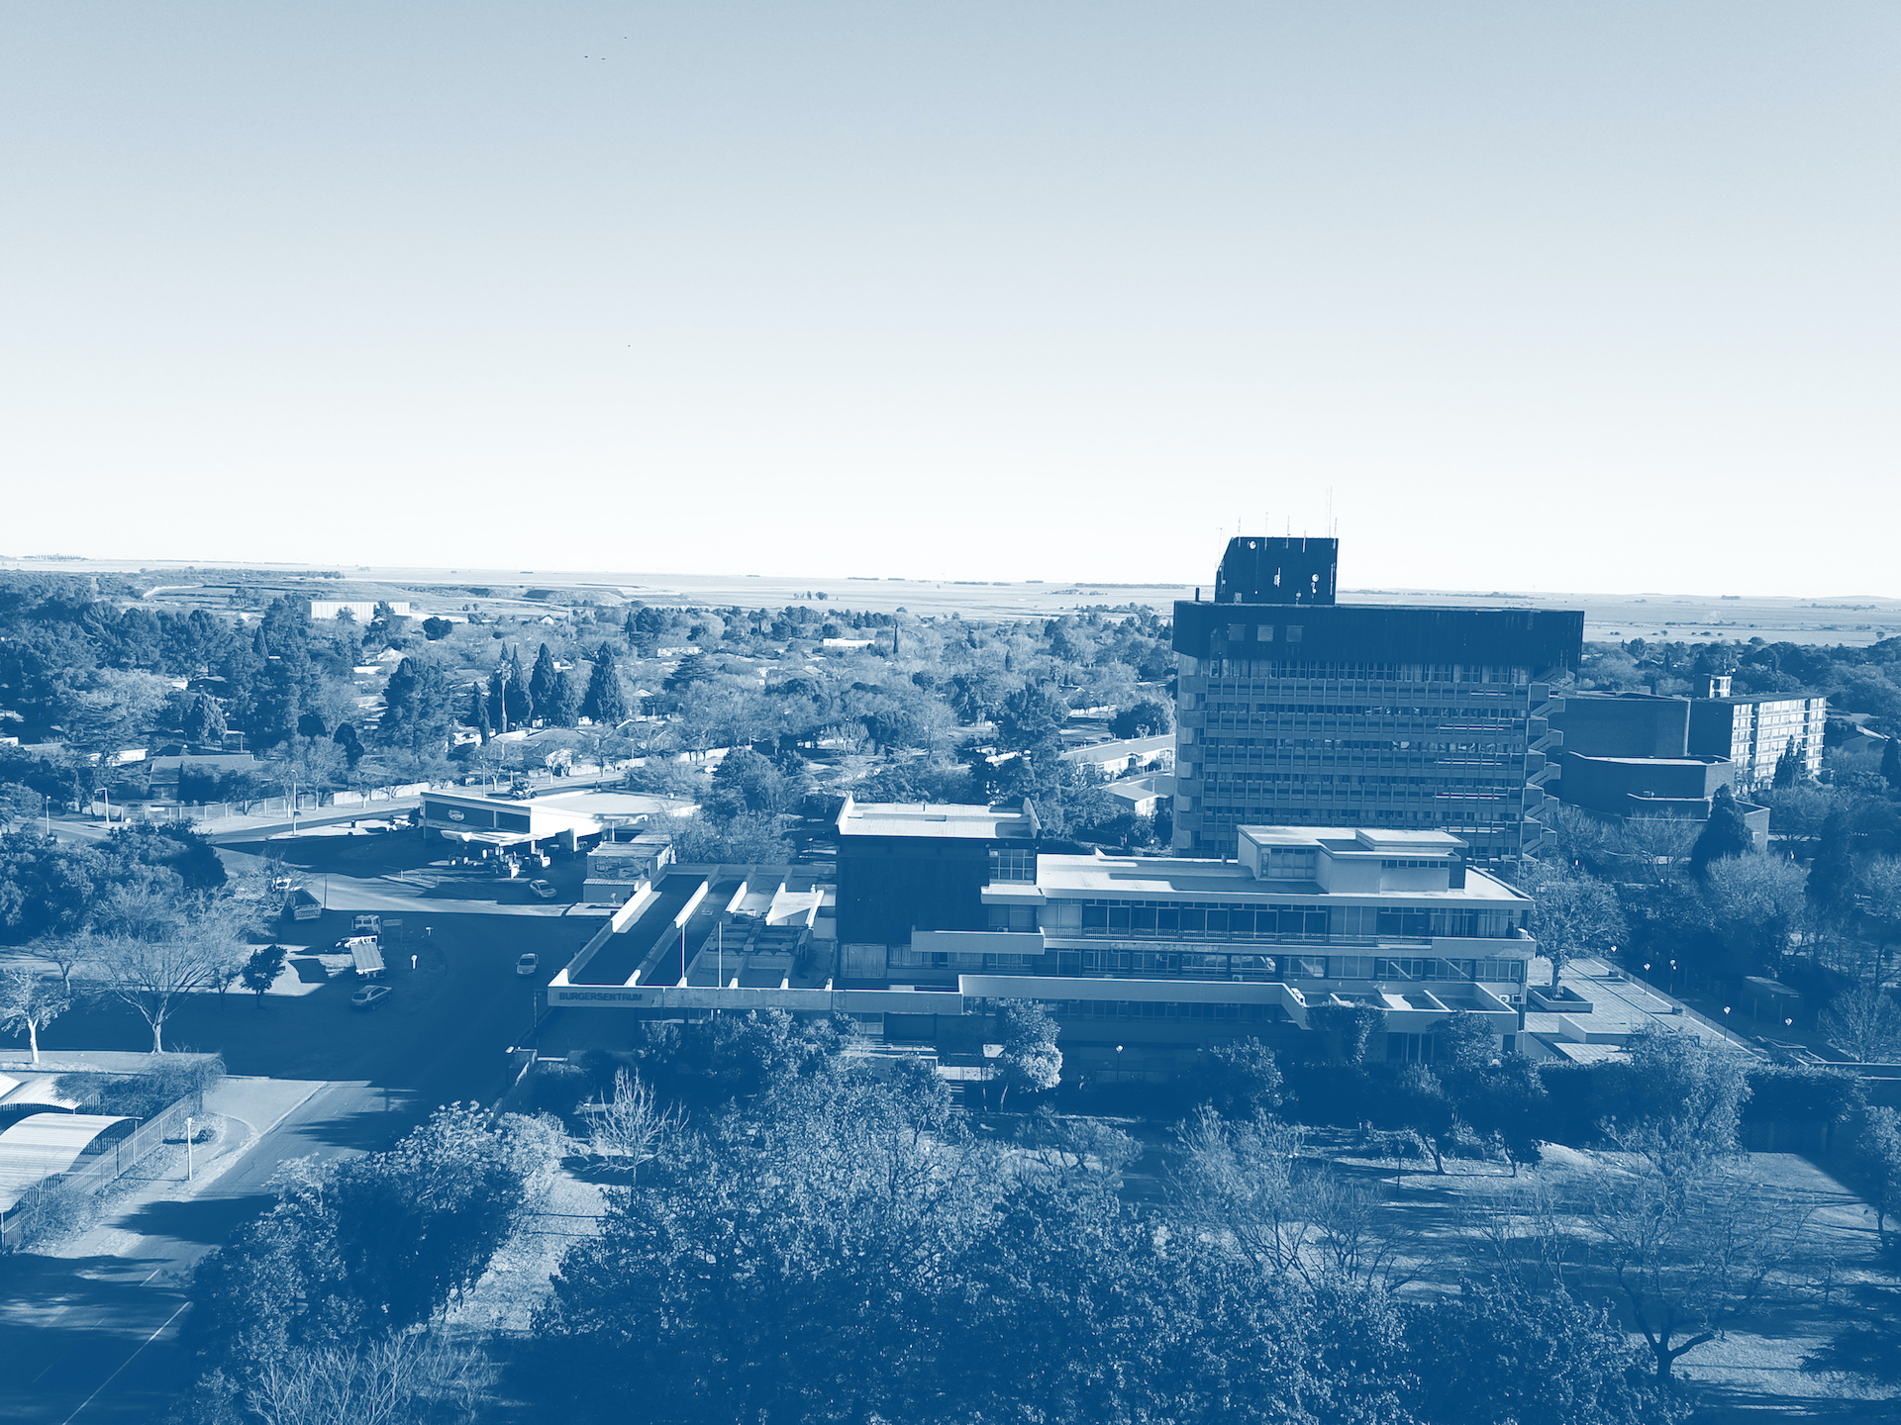
2nd Adjustment Budget 2023/24
Presented by : CFO
: Fikile Mareka
: 14 May 2024

Slide 2
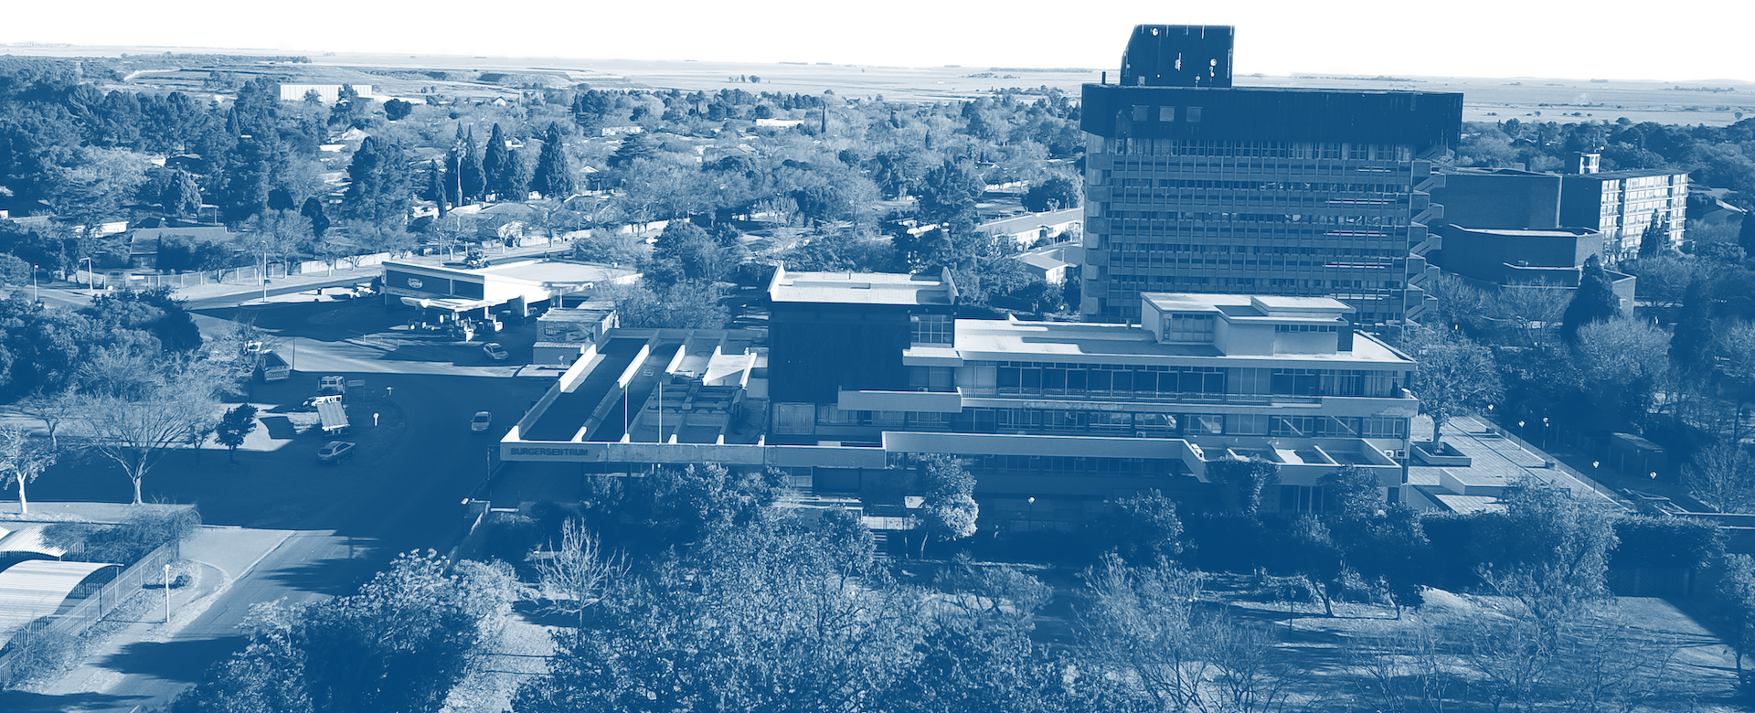
AGENDA
Opening and welcome
Purpose of the meeting
Adjustment budget process
Legislative requirements
Material changes to the annual budget high level
Financial performance revenue and expenditure
Impact of Adjustment budget on Capital budget
Capital Budget analysis

Slide 3
PURPOSE
Purpose of this presentation is to table the 2nd adjustment budget for 2023/24 financial year to Senior Management

Slide 4
2nd ADJUSTMENT BUDGET PROCESS
March 2024
Disaster conditional grant from CoGTA and in-kind allocation received -20 March 2024
April & May 2024
Assessment of 9 months expenditure and revenue Budget . April 2024
May 2024
Mayco approval - 16 May 2024
Council approval 20 May 2024
Departmental budget consultation 6-9 May 2024
Senior management Approval - 14 May
Submission of B Schedule to NT and PT - 31 May 2024

Slide 5
LEGISLATIVE REQUIRMENTS
Section 28 of the Municipal Finance Management Act
Section 24 of the Municipal Budget and Reporting Regulation

Slide 6
material changes in the annual budget 2023/24 high level
1ST ADJUSTMENT BUDGET 2023/24
Financial Performance
Revenue R 1 947 075 275
Expenditure R 1 762 949 635
Surplus R 184 125 639
Own Capital R 65 772 000
Contribution to resv R 0
Financial Position
Current Assets R 1 157 861 723
Current Liabilities R 1 115 555 511
Current ratio 1.04 :1
2nd ADJUSTMENT BUDGET 2023/24
Financial Performance
Revenue R 1 947 075 275
Expenditure R 1 779 673 175
Surplus R 167 402 100
Own Capital R 60 772 000
Contribution to resv R 0
Financial Position
Current Assets R 1 158 861 723
Current Liabilities R 1 115 555 511
Current ratio 1.04:1

Slide 7
material changes in the annual budget 2023/24
During the 1st adjustment budget, Department of Social Services included finance lease budget however the budget was removed as per Provincial Treasury recommendations;
The outcome of assessment condition report performed by Sasol on municipal fleet was not favourable
This had a budget implications and affected operations on landfill site
Section 29 of the MFMA report was subsequently prepared to ensure that health hazard reported by Sasol is addressed.
Other material adjustment that was made is the consultants fees to address the penalty from SARS
The previous security contract has an impact on the current budget of which the budget was not sufficiently budgeted for.
Legal services due to ongoing legal matter and forensic investigation in Finance Department.
Employee cost decreased due operational budget on MIG allocation.

Slide 8
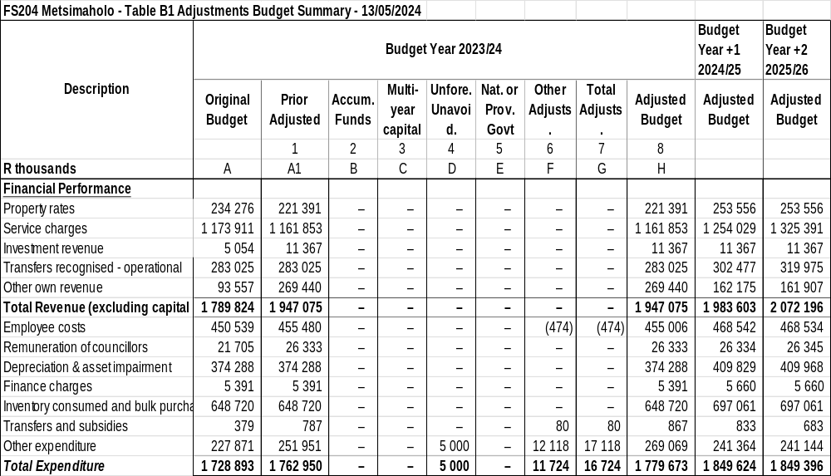
2nd adjustment budget Financial Performance by rev source &exp type

Slide 11
IMPACT OF CAPEX ADJUSTMENT BUDGET ON 2024/24 ANNUAL BUDGET
Funding | 1st Adjustments Budget 2023/24 | 2nd Adjustments Budget 2023/24 | Total budget Year 2023/24 | Budget Year +1 2024/25 | Budget Year +2 2025/26
NATIONAL GRANTS
Integrated National Electrification Program Grant | 29 780 000 | 0 | 29 780 000 | 10 000 000 | 49 201 000
Municipal Infrastructure Grant | 49 399 000 | 0 | 49 399 000 | 49 201 000 | 55 853 000
Regional Bulk Infrastructure Grant | 0 | 0 | 0 | – | –
Water Services Infrastructure Grant | 15 617 000 | 0 | 15 617 000 | 25 961 000 | 27 000 000
PROVINCIAL GRANTS
Production | 0 | 0 | 0 | 30 000 000 | 40 000 000
Disaster grant | 0 | 1 000 000 | 1 000 000
Own Funding | 65 772 000 | (5 000 000) | 60 772 000 | 9 380 000 | 9 380 000
TOTAL CAPITAL BUDGET | 160 568 000 | (4 000 000) | 156 568 000 | 124 542 000 | 181 434 000

Slide 13
CAPEX BUDGET analysis
The municipality has received municipal disaster recovery grant of R1 000 000 on the 20th March 2024
R588 000 of the allocation has already been spent
A budget of R5 000 000 on own funding was reduced to zero due to non-spending

Slide 14

END OF PRESENTATION
Thank You
Fikile Mareka
016
fikile.mareka@metsimaholo.gov.za

